Slide 1
The Hundred Years’ War

Slide 2
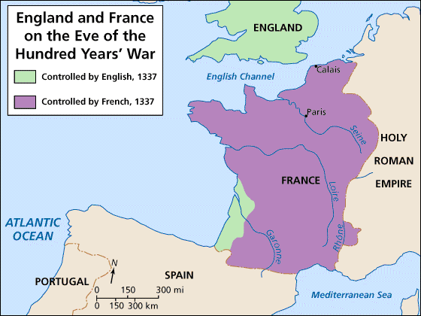
What was it?
Series of wars from 1337-1453
Fought between England and France
Both sides argued about fishing rights in the English Channel
England was mad at France for helping the Scots

Slide 3
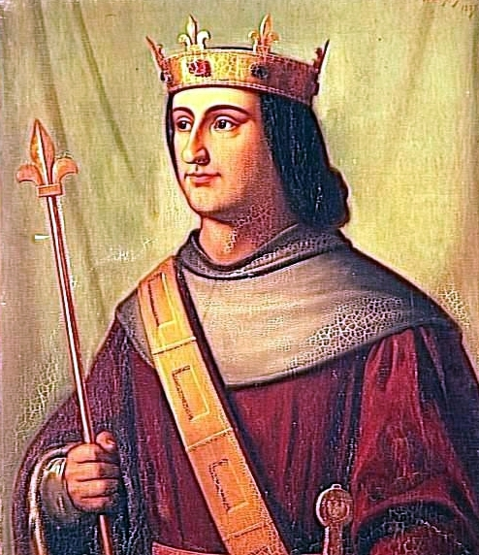
It all started when…
King Philip VI of France captured English controlled Guyenne
England’s King Edward III claimed the French throne because his mother was the sister of French royalty

Slide 4
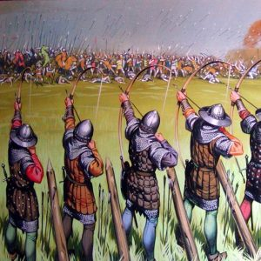
In the beginning
England won many of the early battles due to the new weapon called a longbow
Arrows could travel a long distance and pierce the French armor
Allowed England to win despite being greatly outnumbered

Slide 5
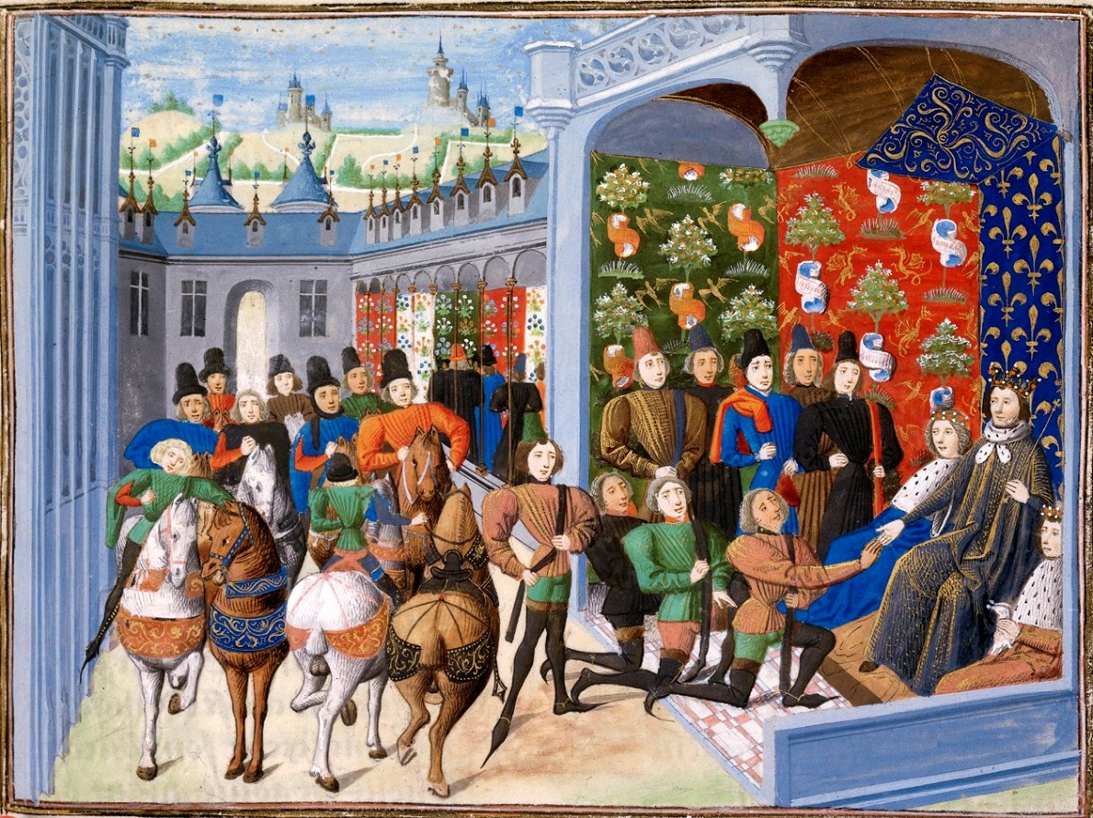
Treaty of Troyes
France agreed to the treaty to end the war
The treaty made England’s King Henry V the heir to the French throne
When Henry died, the French disputed the claim
The war started again

Slide 6
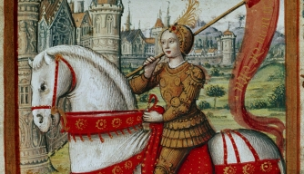
Joan of Arc
A peasant girl who believed she heard messages from God telling her she would lead the French army to victory
French King Charles VII believed her, and gave her command of the army

Slide 7
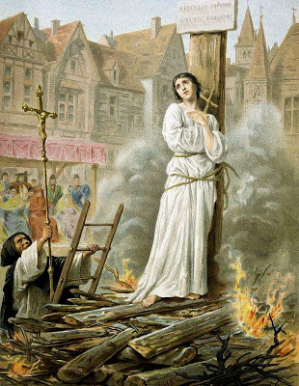
Joan of Arc
Her decision making and leadership inspired the soldiers as they broke the siege of Orleans and defeated the English
Joan was later captured and burned at the stake
The Catholic Church would declare her a saint in 1920

Slide 8
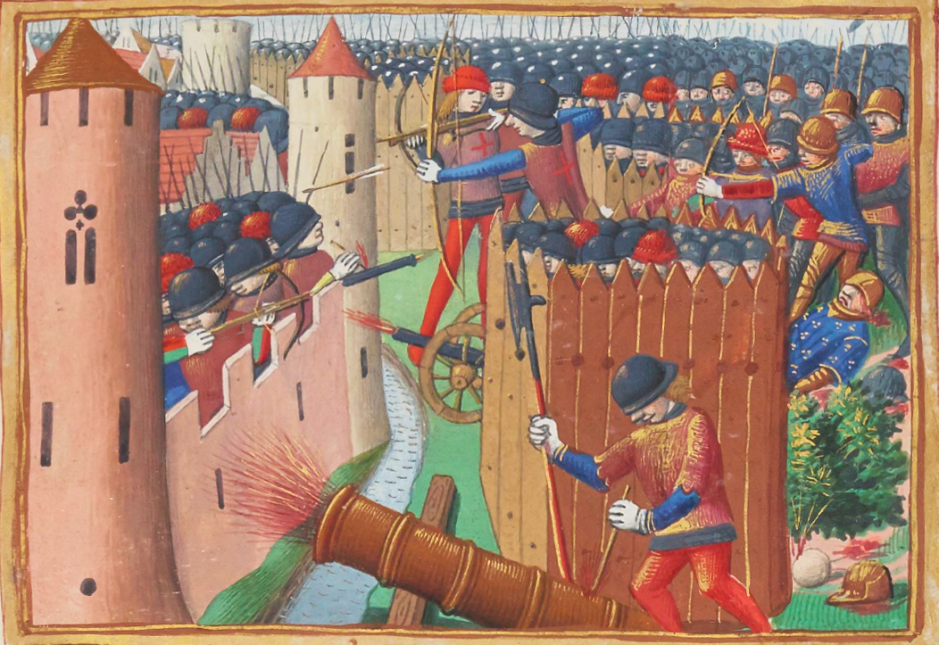
The End of the War
France wins the Hundred Years’ War due to:
Philip the Good switching sides
England fighting over which dynasty will rule
England became weaker
Advanced weaponry such as the cannon
The war helped the decline of feudalism because the castles could not defend against the new cannons

Slide 10
Changes for the Countries
England
Refocused on their government and unified their nation
France
Unified the country with their strong military
The story of Joan of Arc helped develop a French cultural identity

