Slide 1
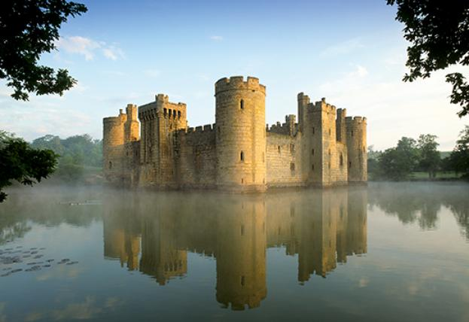
The Feudal System

Slide 2
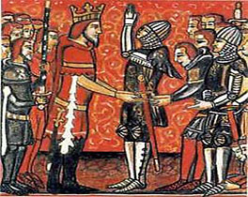
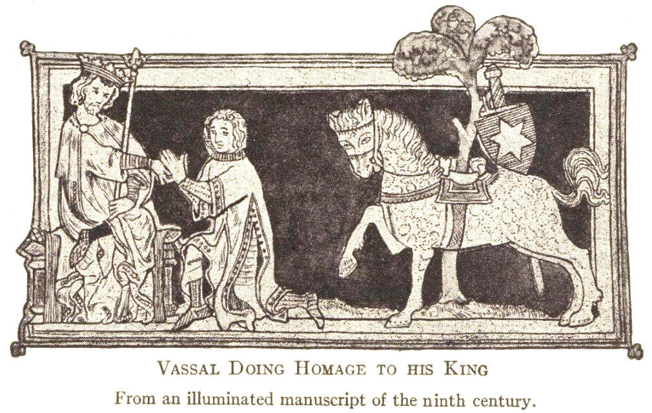
A New System
Feudalism- wealthy landholders give land in exchange for loyalty
Vassal- a less wealthy noble who pledged his loyalty to the lord in exchange for land
Could give land to knights, clergy, or other nobles
Made peasants and serfs do the work

Slide 3
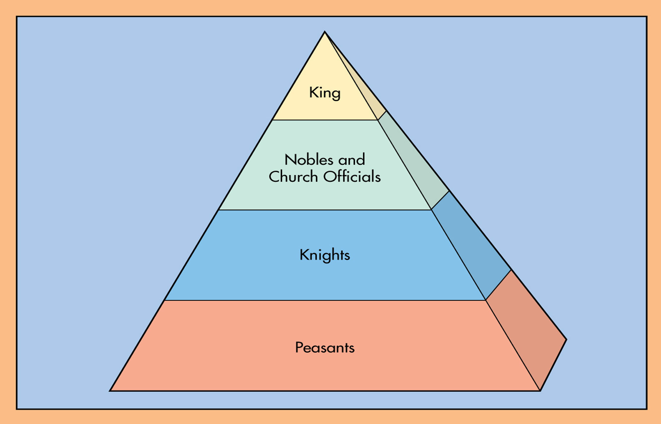

Slide 4
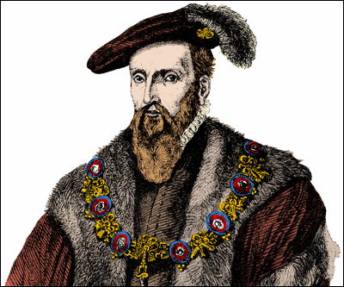
Feudal Society
King
Ruled the kingdom, but did not have a lot of power
Lords controlled most of the manor lands
Nobles and Church Officials
Dukes and barons
Church officials

Slide 5
Feudal Society
Knights
Professional soldiers who fought for their lord
Chivalry- code of courage, bravery, loyalty, and respect for women
Peasants
Worked the land and did other jobs for the lord
Had few rights and poor living conditions

Slide 6
Manorialism
Manorialism- A system in which serfs live and work on a manor in return for land and protection from the lord
Serf- a person who was allowed to have a house and a plot of land in return for paying rent to their lord
Serfs could not leave the manor

Slide 7
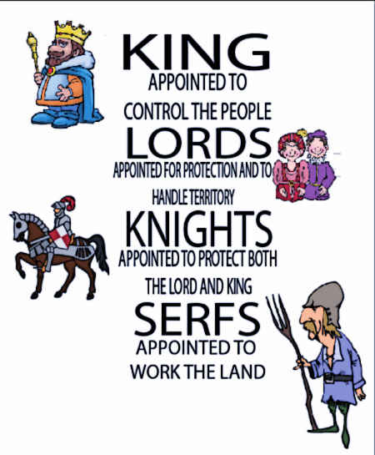

Slide 8
