Slide 1
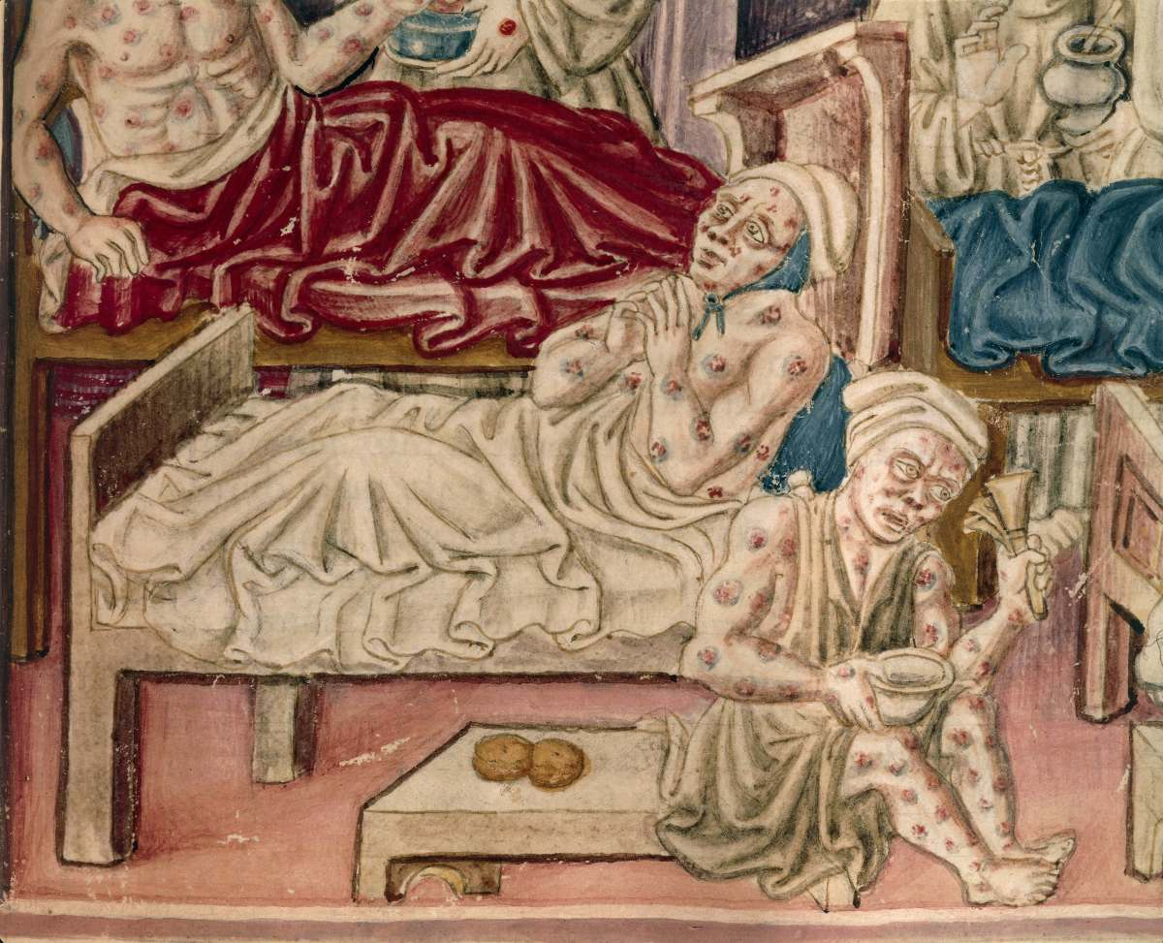
The Black Death

Slide 2
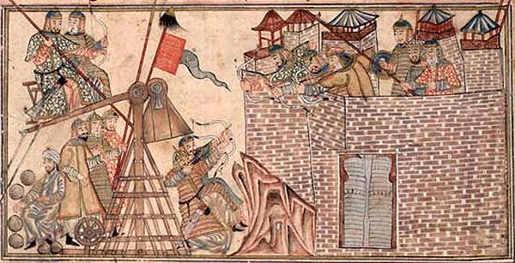
Where It Began
Plague started in East Asia
Mongols carried it to China and Caffa
Italian traders escaped the city
Brought the disease with them to Europe

Slide 3
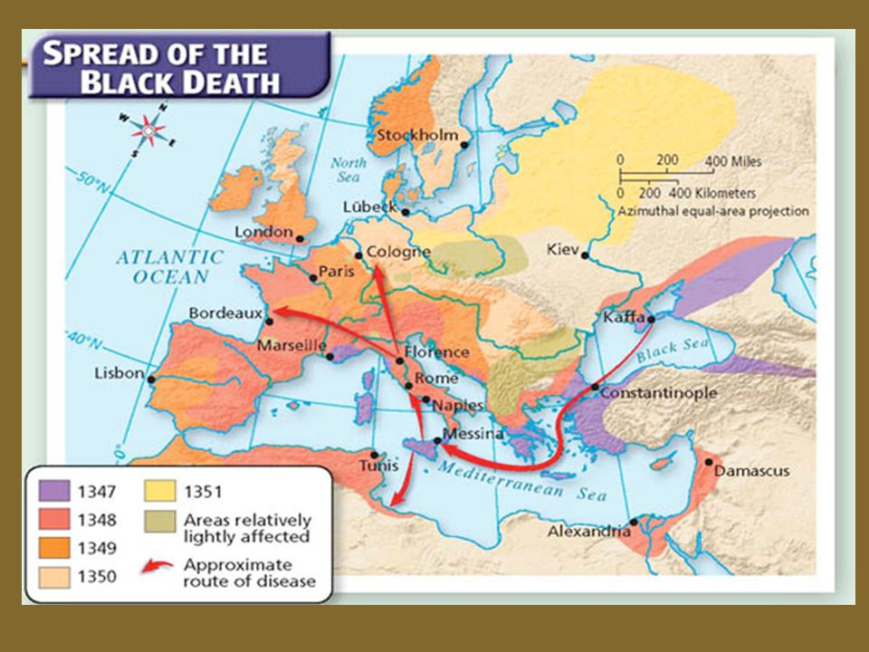
The Plague Enters Europe
The Black Death was carried to the sea ports and then along the trade routes
In some cities, the death rate was above 50%
The Plague is responsible for killing 1/3 of Europe’s population

Slide 4
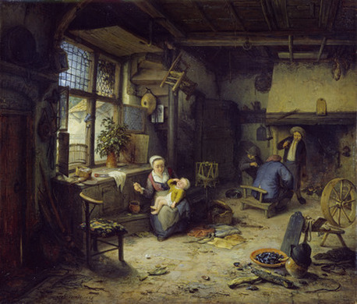
Poor Living Conditions
Rushes (grass-like plant) used as floor covering
Absorbed food and liquids spilled on the floor
Rotted and grew germs
People threw their waste into the streets

Slide 5
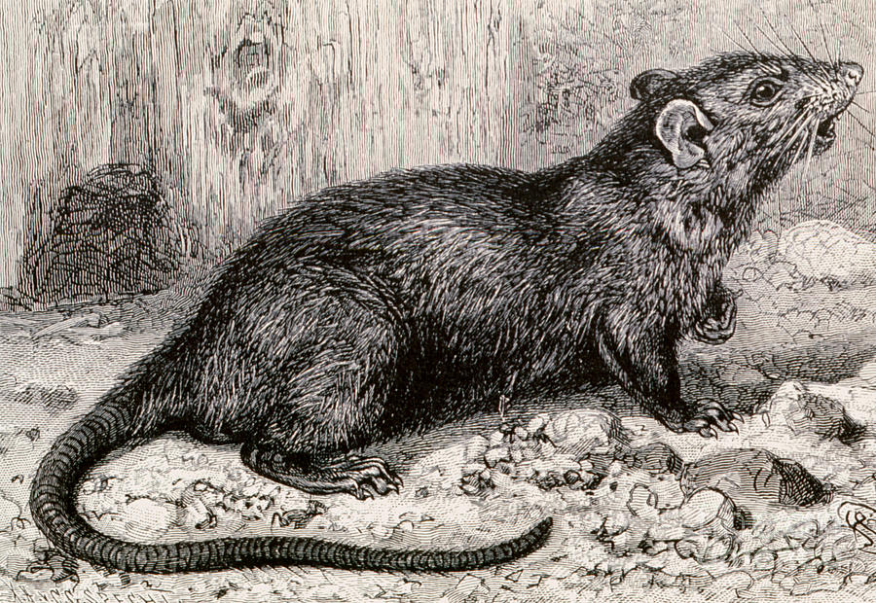
Rats!
Rat population increased due to the conditions
Rats carried the Plague infected fleas
Fleas would infect the rats and then the people

Slide 6
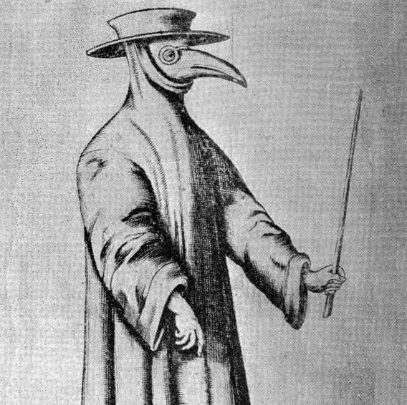
Don’t Come Near Me!
People avoided contact with each other
Doctors, lawyers, and priests stopped doing their jobs
People fled the cities for the country
The disease followed them
Farmers and animals died from the Plague

Slide 7
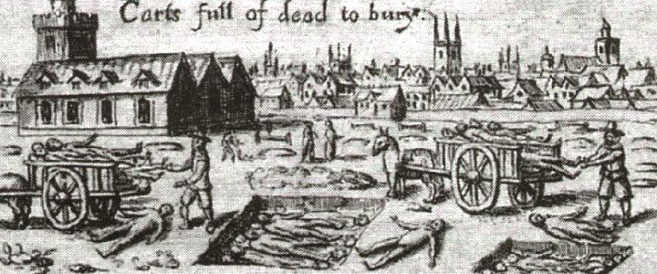
God’s Punishment
People believed God was punishing them for bad behavior
Others wondered why God was not helping them
People started looking to science for answers instead of religion

Slide 8
No People, No Workers
Projects were abandoned due to no skilled workers
Farms became pastures with no farmers
Landowners went broke since there was no one to do their jobs
Trade decreased with fewer sailors
People also did not want to travel and get sick

Slide 9
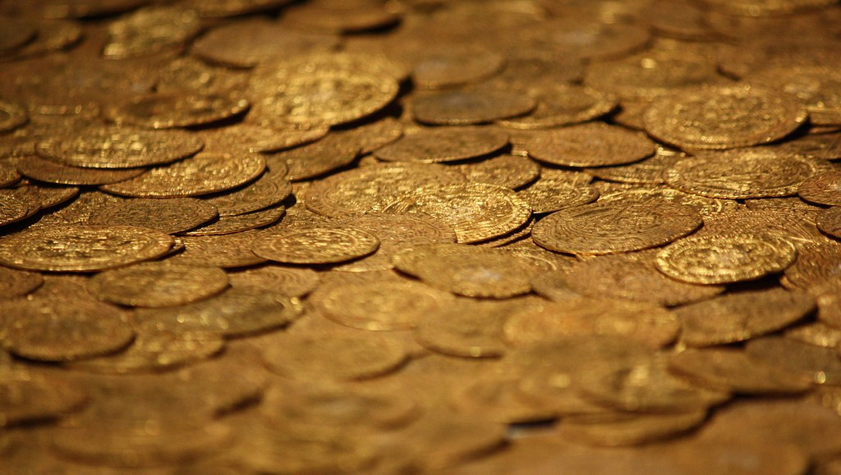
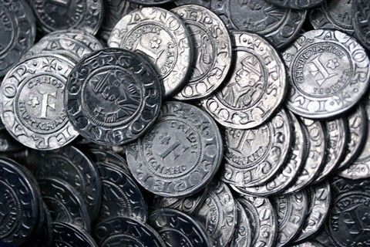
Show Me the Money!
Those who survived demanded higher wages
Increased wealth and improved living conditions
People inherited wealth from dead relatives
Increased wealth lead to increases in spending

Slide 10
Changes to Society
Farm workers could demand better treatment
Some left for more money, better jobs
Wages for skilled labor increased
Serfs could learn a trade and become wealthy
Old leaders lost power due to lower classes gaining wealth
Catholic Church lost power and influence
People lost the faith due to the Plague

