Slide 1
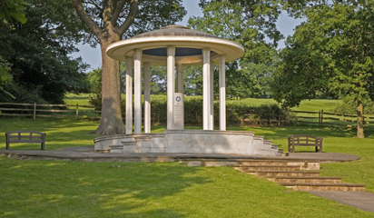
Magna Carta

Slide 2
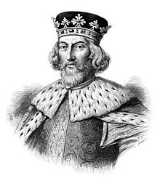
King John
After the death of Richard the Lionhearted, his brother John became king in 1199
King John was very unpopular
Many conflicts between the social classes

Slide 3
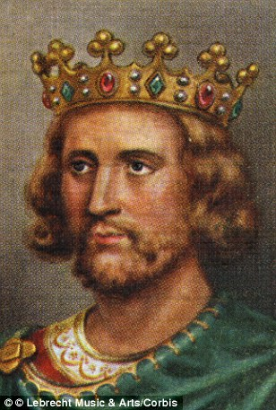
Bad King
Barons thought he interfered too much. King John ignored the barons.
Passed unfair laws.
King John got in an argument with the Pope.
King John lost wars with France and lost land.
He raised taxes to pay for his wars.
He was rumored to have killed his nephew to keep him from becoming king.

Slide 4
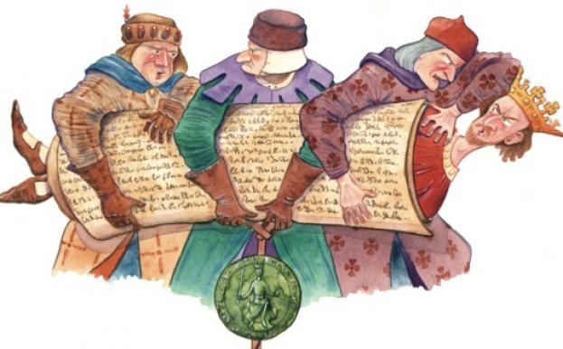
Enough!
The barons rebelled in 1215
They had two options:
Overthrow the king and replace him.
Make him do what they wanted.
They formed an army and surrounded the king

Slide 5
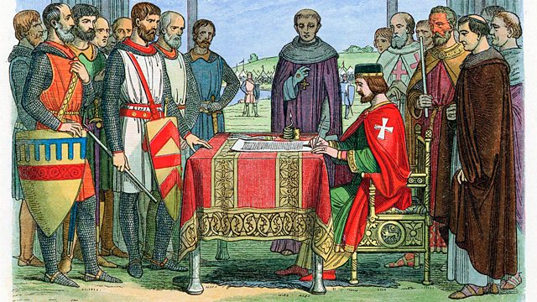
Magna Carta
On June 19, 1215, King John signed the Magna Carta at Runnymede
Limited the king’s power
Gave people more freedoms

Slide 6
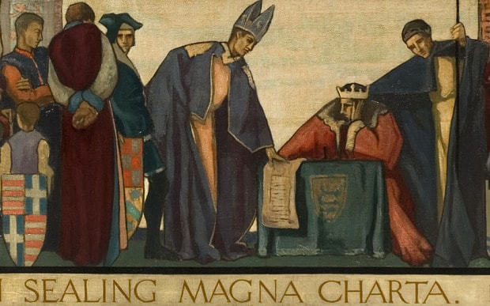
Changes in England
King
Could no longer jail nobles without reason
Must get approval by Great Council to raise taxes
Could not take church property
People
More of a voice in the government
Protected basic rights
Nobles and clergy had a say in the king’s rule

Slide 7
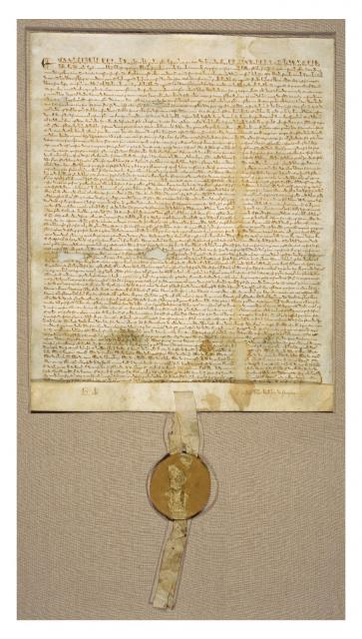
Impact on Us
Ideas helped create the U.S. Constitution
Helped establish our law system
Right to a fair trial by jury (Due Process)
Government must follow rules and procedures

Slide 8
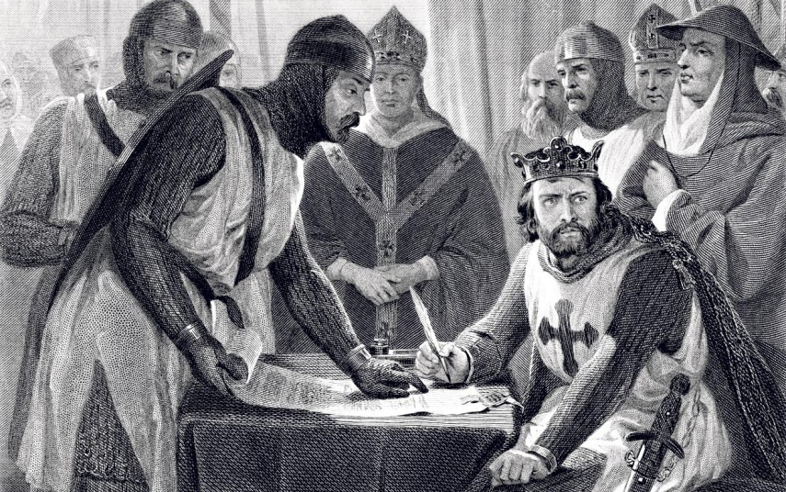
Aftermath
John tried to get out of the Magna Carta
John tried to say no one could limit the king’s power
King John died in 1216
His son, Henry, and William Marshall re-issued the Magna Carta

