Slide 1
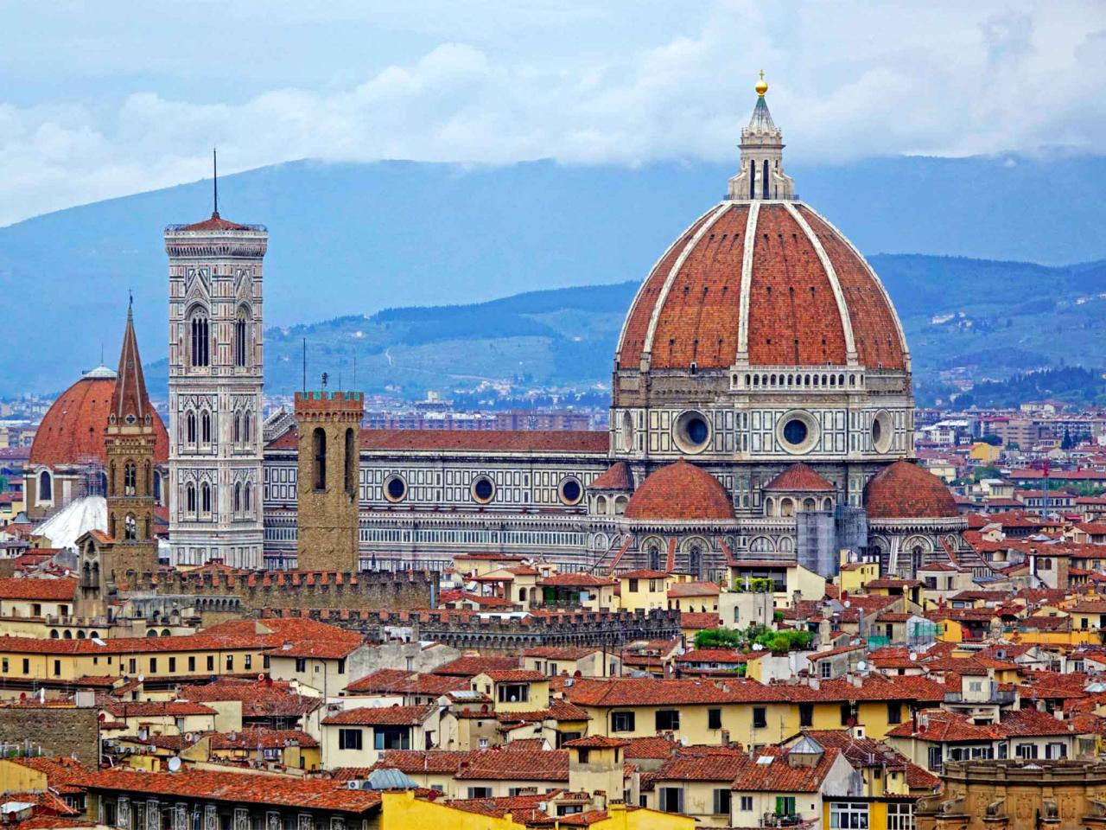
Birthplace of the Renaissance

Slide 2
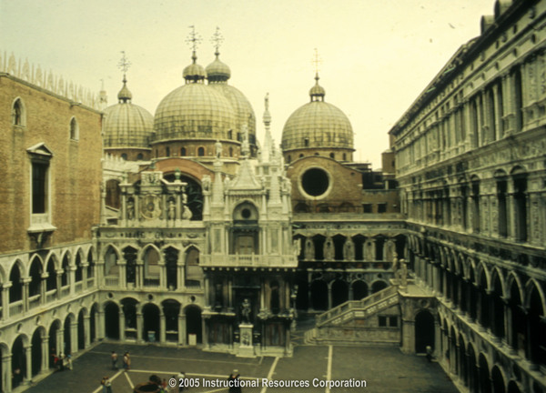
Italian Government
Two types of government
Signoria, Republicanism
Government ran by wealthy merchants
Merchants- people who provide materials, products, or services to a buyer, usually in exchange for money

Slide 3
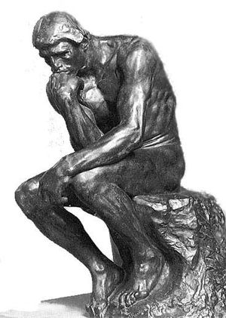
Humanism
Humanism- a movement where people believe in individuals ability to influence the world around them, not just accept the world as they found it
Emphasized the importance of free thinking and problem solving in the development of new ideas

Slide 4
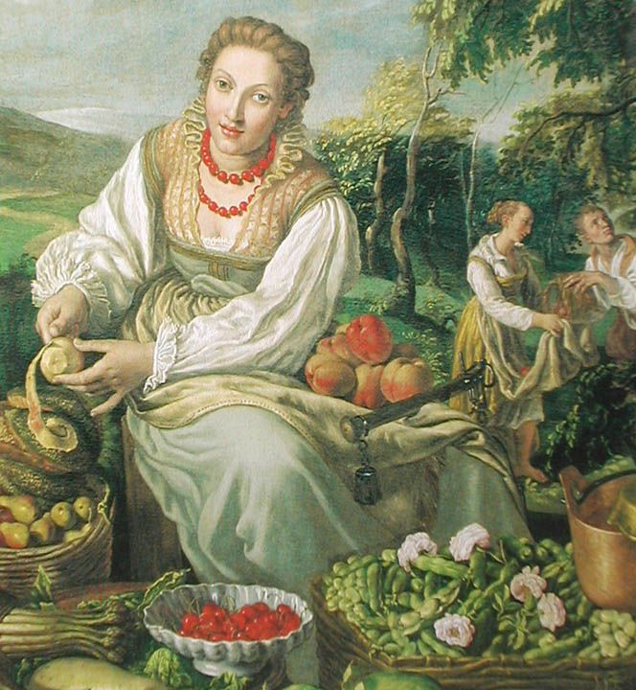
Greek and Roman Influence
Art began to focus on humans instead of religion
Artists painted what they saw around them
Science was advanced by the humanist ideals of examining the natural world and challenging existing ideals

Slide 5
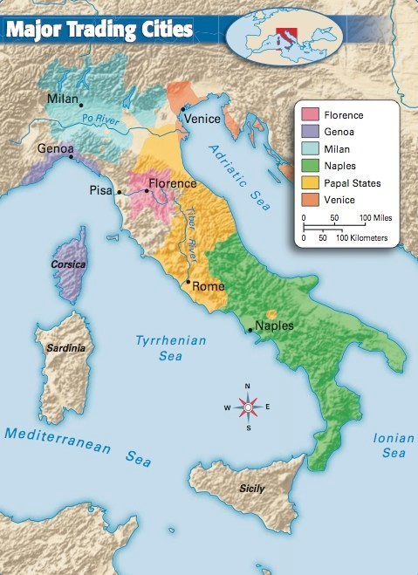
Renaissance in Italy
City-states grew rich from trade
Imports and exports
Florence, Milan, Venice were the most powerful cities

Slide 6
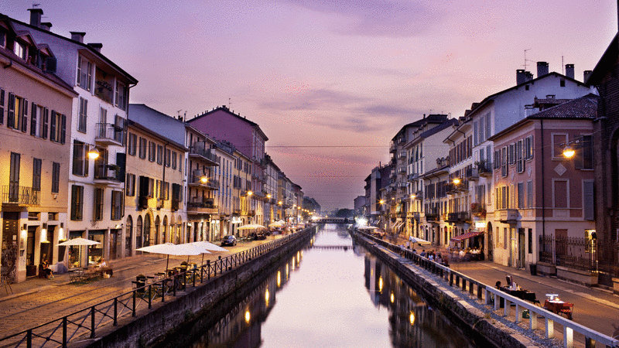
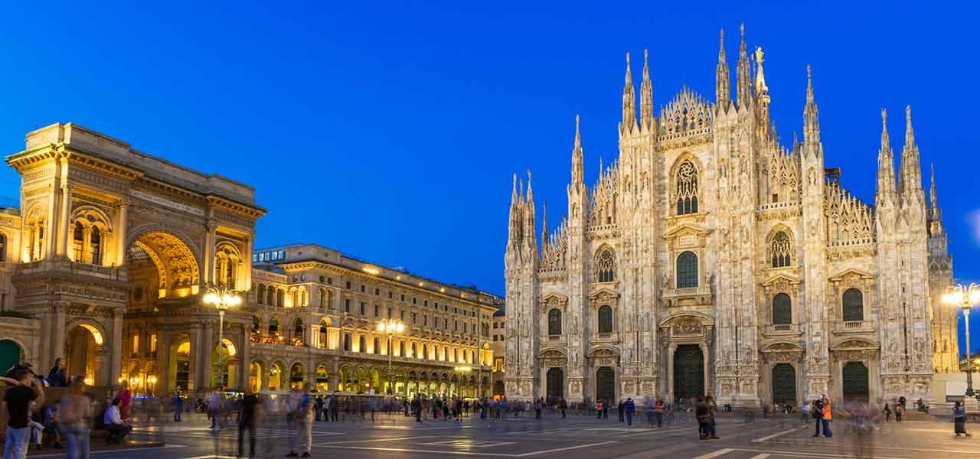
Milan and Venice
http://foundtheworld.com/top-10-tourist-attractions-in-venice-italy/

